Slide 1
Course Code:CSC402A Course Title: Web Architecture and Application Development
Course Leader:
Kishore S.M.
kishore.cs.et@msruas.ac.in

Slide 2
Objectives
At the end of the lecture, students will be able to
Explain about Web browsers
Analyze the features of HTML

Slide 3
Contents
Web browsers
HTML

Slide 4
Web Browsers
Some of the responsibilities of web browsers
Generate and send requests to Web servers on the user’s behalf, as a result of following hyperlinks, explicit typing of URLs, submitting forms, and parsing HTML pages that require auxiliary resources (e.g. images, applets)
Accept responses delivered by Web servers and interpret them to produce the visual representation to be viewed by the user
Render the results in the browser window or through a third party tool, depending on the content type of the response
Caching: the browser must make determinations as to whether or not it needs to request data from the server at all. It may have a cached copy of the same data item that it retrieved during a previous request

Slide 5
Web Browsers
Authentication: since web servers may require authorization credentials to access resources it has designated as secure, the browser must react to server requests for credentials, by prompting the user for authorization credentials
State maintenance: to record and maintain the state of a browser session across requests and responses, web servers may request that the browser accept cookies, which are sets of name/value pairs included in response headers
Rendering complex objects: most web browsers inherently support content types such as text/html, text/plain, image/gif, and image/jpeg
Dealing with error conditions: connection failures and invalid responses from servers are among the situations the browser must be equipped to deal with

Slide 6
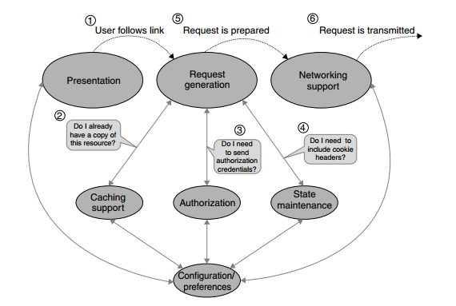
Web Browsers
Below image shows the processing flow for the creation and transmission of a request in a typical browser
Browser Request Processing

Slide 7
Web Browsers
Important events in the User Interface Module
Entering URL’s manually
Selecting previously visited links
Selecting displayed hyperlinks
Once the URL has been resolved, the Request Generation module builds the request, which is ultimately passed to the Networking module for transmission. To accomplish this task, the Request Generation module has to communicate with other browser components:
It asks the Caching module “Do I already have a copy of this resource?”
It asks the Authorization module “Do I need to include authentication credentials in this request?”

Slide 8
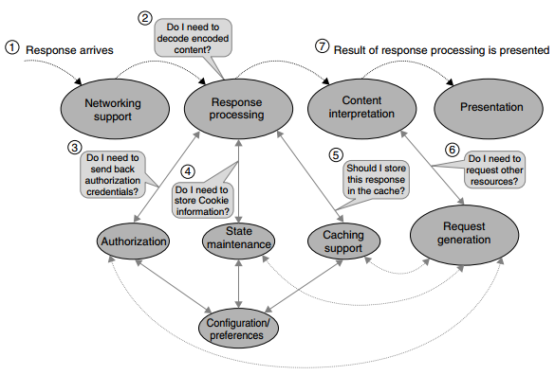
Web Browsers
• It asks the State Mechanism module “Do I need to include Cookie headers in this request?”
Below image shows the browser response processing
Browser Response Processing

Slide 9
Web Browsers
Response Processing module examines response headers to determine required actions
If the status code of the response is 401 Not Authorized, this means that the request lacked necessary authorization credentials
If the response contains Set-Cookie headers, the State Maintenance module must store the cookie information using the browser’s persistence mechanism
If the response contains Content-Transfer-Encoding and/or Content-Encoding headers, the module needs to decode the body of the response
• The module examines the Cache-Control, Expires, and/or Pragma headers (depending on the HTTP version of the response) to determine whether the browser needs to cache the decoded content of the response

Slide 10
Web Browsers
The Content-Type header determines the MIME type of the response content
Different MIME types, naturally, require different kinds of content processing
Modern browsers support a variety of content types natively, including HTML (text/html), graphical images (image/gif, and image/jpeg), and sounds (audio/wav).
Some content types (e.g. markup languages, applets, Flash movies) may embed references to other resources needed to satisfy the request
For instance, HTML pages may include references to images or JavaScript components

Slide 11
HTML
HTML stands for Hyper Text Markup Language, which is the most widely used language on Web to develop web pages
Over the last ten years, the HTML specification has gone through a number of transformations
HTML was created by Berners-Lee in late 1991 but "HTML 2.0" was the first standard HTML specification which was published in 1995
HTML 4.01 was a major version of HTML and it was published in late 1999
We are having HTML-5 version which is an extension to HTML 4.01, and this version was published in 2012

Slide 12
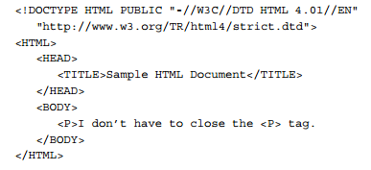
HTML
HTML Structure and Syntax
HTML header

Slide 13
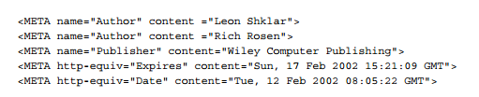
HTML
The recently added <META> element provides a lot more flexibility in defining document properties and providing input to browsers and other user agents
Other elements that are defined in the HTML header section include <STYLE> and <SCRIPT>

Slide 14
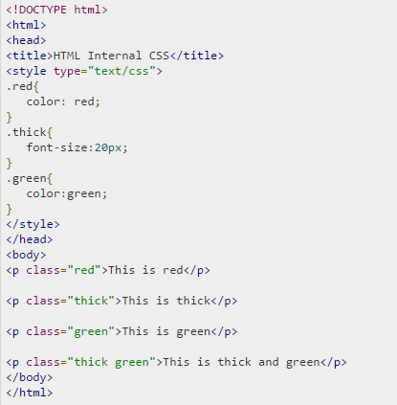
HTML
The <STYLE> element is designed to alter the default browser behavior when rendering the body of the markup

Slide 15
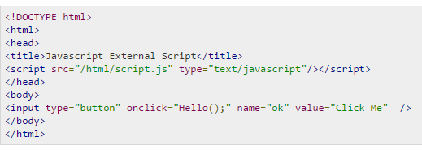

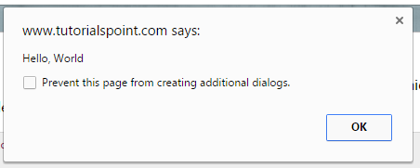
HTML
The <SCRIPT> element, in combination with event handlers that may be referenced from the body of the document, is designed to provide access to browser objects that get created when processing HTTP responses.
External JavaScript
Script.js

Slide 16
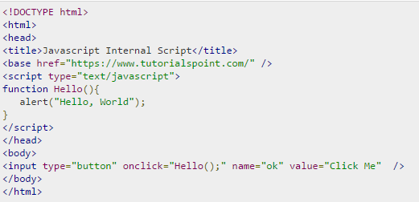
HTML
Internal Script

Slide 17
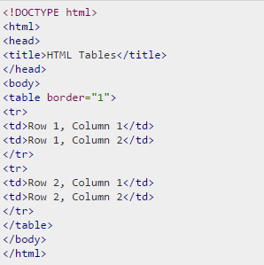

HTML
HTML body
Content of an HTML document is included within the <BODY> element
The most commonly used ones include
<TABLE>

Slide 18
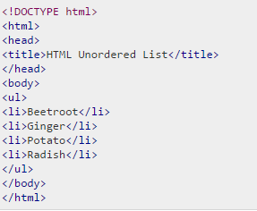
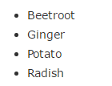
HTML
<UL> - An unordered list. This will list items using plain bullets

Slide 19
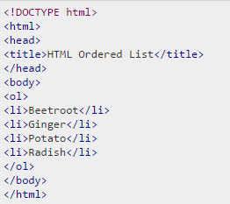
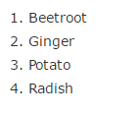
HTML
<OL> - An ordered list. This will use different schemes of numbers to list your items

Slide 20
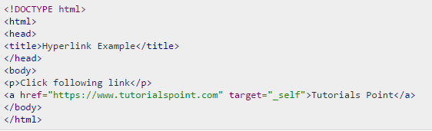

HTML
Other important elements include anchors that reference documents or locations within documents, and image elements

Slide 21
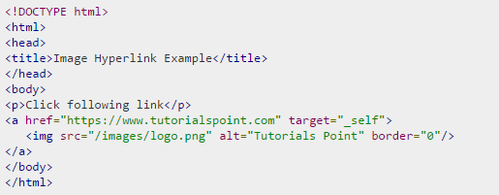

HTML

Slide 22
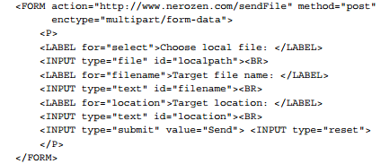
HTML
HTTP Requests
Most browsers provide a number of options for generating HTTP requests. The most obvious are following a hyperlink, or specifying a URL (by typing it in, selecting a bookmark or a history entry, etc.).

Slide 23
HTML
HTTP Rendering
Cascading Style Sheets
Cascading Style Sheets (CSS) is a mechanism for controlling style (e.g. fonts, colors, spacing) for HTML
A style sheet is made up of rules, each of which applies to an HTML element and controls a certain aspect of its rendering
There are various ways of associating these style rules with HTML documents, but the easiest is to use the HTML <STYLE> element, which is placed in the document HEAD and contains style rules for the page

Slide 24
HTML
P { font: italic bold 12pt/14pt Times, serif; color: #0000F0 }
P { font-size: medium; color: blue }
P { font-size: larger }
BODY { margin-top: 0 }
DT { margin-bottom: 2em }
A:visited { border: thin dotted #800080 }
P { display: list-item }

Slide 25
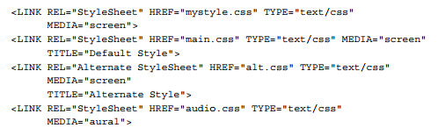
HTML
Associating styles with HTML documents
The approach that provides the highest degree of separation between HTML markup and style-based rendering is based on linking HTML documents with external style sheets, which do not contain any HTML markup, only style commands.

Slide 26
Summary
HTML stands for Hyper Text Markup Language, which is the most widely used language on Web to develop web pages

